Slide 1
Notes:
Handouts Option: You will likely reference the 2018 GOTV Guide.

Slide 2
WHAT IS A PRECINCT COMMITTEEPERSON?
TRAINER NAME
Notes:
Update slide with name.
Language: This is your chance to intro the session title and yourself. Give trainees the 2 minute version of who you are and why you are excited to be in the room training. Use this time to establish credibility within the room and set the tone for the session.

Slide 3
AGENDA
1
Welcome, Introductions, and Overview
2
Responsibilities
3
Organizing My Precinct
4
Getting Out the Vote in My Precinct
5
Debrief
Notes:
NOTE: Walk through the agenda for the session. This exact slide will appear in between sections throughout the entire training deck.

Slide 4
AGENDA
1
Welcome, Introductions, and Overview
2
Responsibilities
3
Organizing My Precinct
4
Getting Out the Vote in My Precinct
5
Debrief

Slide 5
SOME OF US WEAR MANY HATS…
Today we’ll focus on your work as a
Precinct Committeeperson.
Notes:
LANGUAGE: Throughout this session we have 3 main objectives we want to accomplish. First, we’re going to recognize your statutory responsibilities as a PC – what you are legally expected to do. Then, we’ll discover how to organize our precincts. Finally, we’ll prepare to Get Out the Vote for Democratic Candidates.
NOTE: This session is largely overview. Our goal is to build a sense of identity, not answer every question about being a PC.

Slide 6
OBJECTIVES
Recognize Statutory Responsibilities
Discover How to Organize Precincts
Prepare to Turn Out Base Voters During GOTV
Notes:
LANGUAGE: Throughout this session we have 3 main objectives we want to accomplish. First, we’re going to recognize your statutory responsibilities as a PC – what you are legally expected to do. Then, we’ll discover how to organize our precincts. Finally, we’ll prepare to Get Out the Vote for Democratic Candidates.
NOTE: This session is largely overview. Our goal is to build a sense of identity, not answer every question about being a PC.

Slide 7
LEADERSHIP WITH VOTER TURNOUT
Individual campaign
VOTER TURNOUT
Statewide coordinated campaign
Precinct committeeperson
Local Democratic Party
Notes:
NOTE: Do not get into the specifics of every single part of voter turnout. Illustrate the importance of the precinct committeeperson.
LANGUAGE: The precinct committeeperson plays a critical role in voter turnout through getting out the voter for base Democratic voters in their precinct, people who the precinct committeeperson has built relationships with throughout the year. The local Democratic Party is generally focused on getting out the Democratic vote with the entire local party’s regional area. Individual campaigns are focused on a particular candidate, and statewide coordinated campaigns are working with candidates to get out the vote for people who support the candidates, which can included voters they worked to persuade.

Slide 8
BASE VOTER
A base voter is any voter we can count on to support Democratic candidates. These voters will be targeted differently in each area.

Slide 9
AGENDA
1
Welcome, Introductions, and Overview
2
Responsibilities
3
Organizing My Precinct
4
Getting Out the Vote in My Precinct
5
Debrief

Slide 10
What are the statutory responsibilities of a precinct committeeperson?
Notes:
LANGUAGE: There are a lot of responsibilities for precinct committeepeople, but there are a couple of legal, or statutory, responsibilities. What are some of those statutory responsibilities you have as PCs?

Slide 11
STATUTORY RESPONSIBILITIES
Serve on the Central Committee
Recommend election judges
to the local election authority
Notes:
LANGUAGE: The two essential, legally expected responsibilities for a PC are to serve on the County Democratic party’s Central Committee, and to recommend election judges to your local election authority.

Slide 12
CENTRAL COMMITTEE RESPONSIBILITIES
Elects officers according to their bylaws
Stewards the party’s mission and resources
Notes:
LANGUAGE: As a member of your central committee, your first responsibility after being elected is to elect your party’s officers. Of course, only elected PCs get to participate in the election of your chair – so appointed folks will need to make sure they’re on the ballot the next time. The exact way the rest of your officers are elected will vary by your county party’s bylaws.
Your second responsibility is really significant. You are a steward of your party’s mission and resources. As a member of the Central Committee, you have a say and a vote on issues. You also can bring your own ideas to the table, and get involved in committees or working groups to bring those ideas to life.

Slide 13
ELECTION JUDGES
Fairly
In accordance with the law
Notes:
LANGUAGE: The other key responsibility of a PC is recommending Election Judges. Has anyone done this already?
That’s great – election judges are an important part of our election experience. These are the people who hand you your ballot and answer your questions. They are legally responsible for making sure that elections are carried out fairly and in accordance with the law.
But by recommending good people to be judges, we can also ensure that voters in our precinct will have a positive experience at the polls. A good election judge will help a voter feel welcomed and empowered. This is especially important for new voters with questions about the process.
And as a Democrat, you will play a crucial role in ensuring the election judges voters in your precinct interact with represent the diversity of your community.

Slide 14
WHO CAN BE AN ELECTION JUDGE?
An election judge
1
Must be a registered voter
2
Must be of good repute and character
3
Must be able to read and write the English language
4
Cannot be a candidate for any office in the election
5
Cannot be a precinct committeeperson
6
Must complete certification through the election authority
*Adapted from the “Precinct Committee person Guidebook”
by the Illinois Democratic County Chairs’ Association “Precinct Committeeperson Guidebook.”
Notes:
There aren't many prerequisites for becoming an election judge – there is no special degree or license required. To legally qualify as an election judge, a person:
must be a registered voter
must be of good repute and character – this basically means they person cannot be a registered sex offender.
must be able to read and write the English language
cannot be a candidate for any office in the election
cannot be a precinct committeeperson
must complete certification (i.e., training) through the election authority – but they will do that after you’ve recommended them
They must also live in the precinct where they will serve – but, and this is a significant but, one Democratic judge in each precinct can live in another precinct in the same county. So if you’re feeling limited, one of your recommendations can come from a precinct with an abundance of qualified Democrats.

Slide 15
What are the statutory responsibilities of a precinct committeeperson?
Notes:
Language: Ok, let’s review! What are the two statutory responsibilities of a PC? (Check for retention)

Slide 16
AGENDA
1
Welcome, Introductions, and Overview
2
Responsibilities
3
Organizing My Precinct
4
Getting Out the Vote in My Precinct
5
Debrief

Slide 17
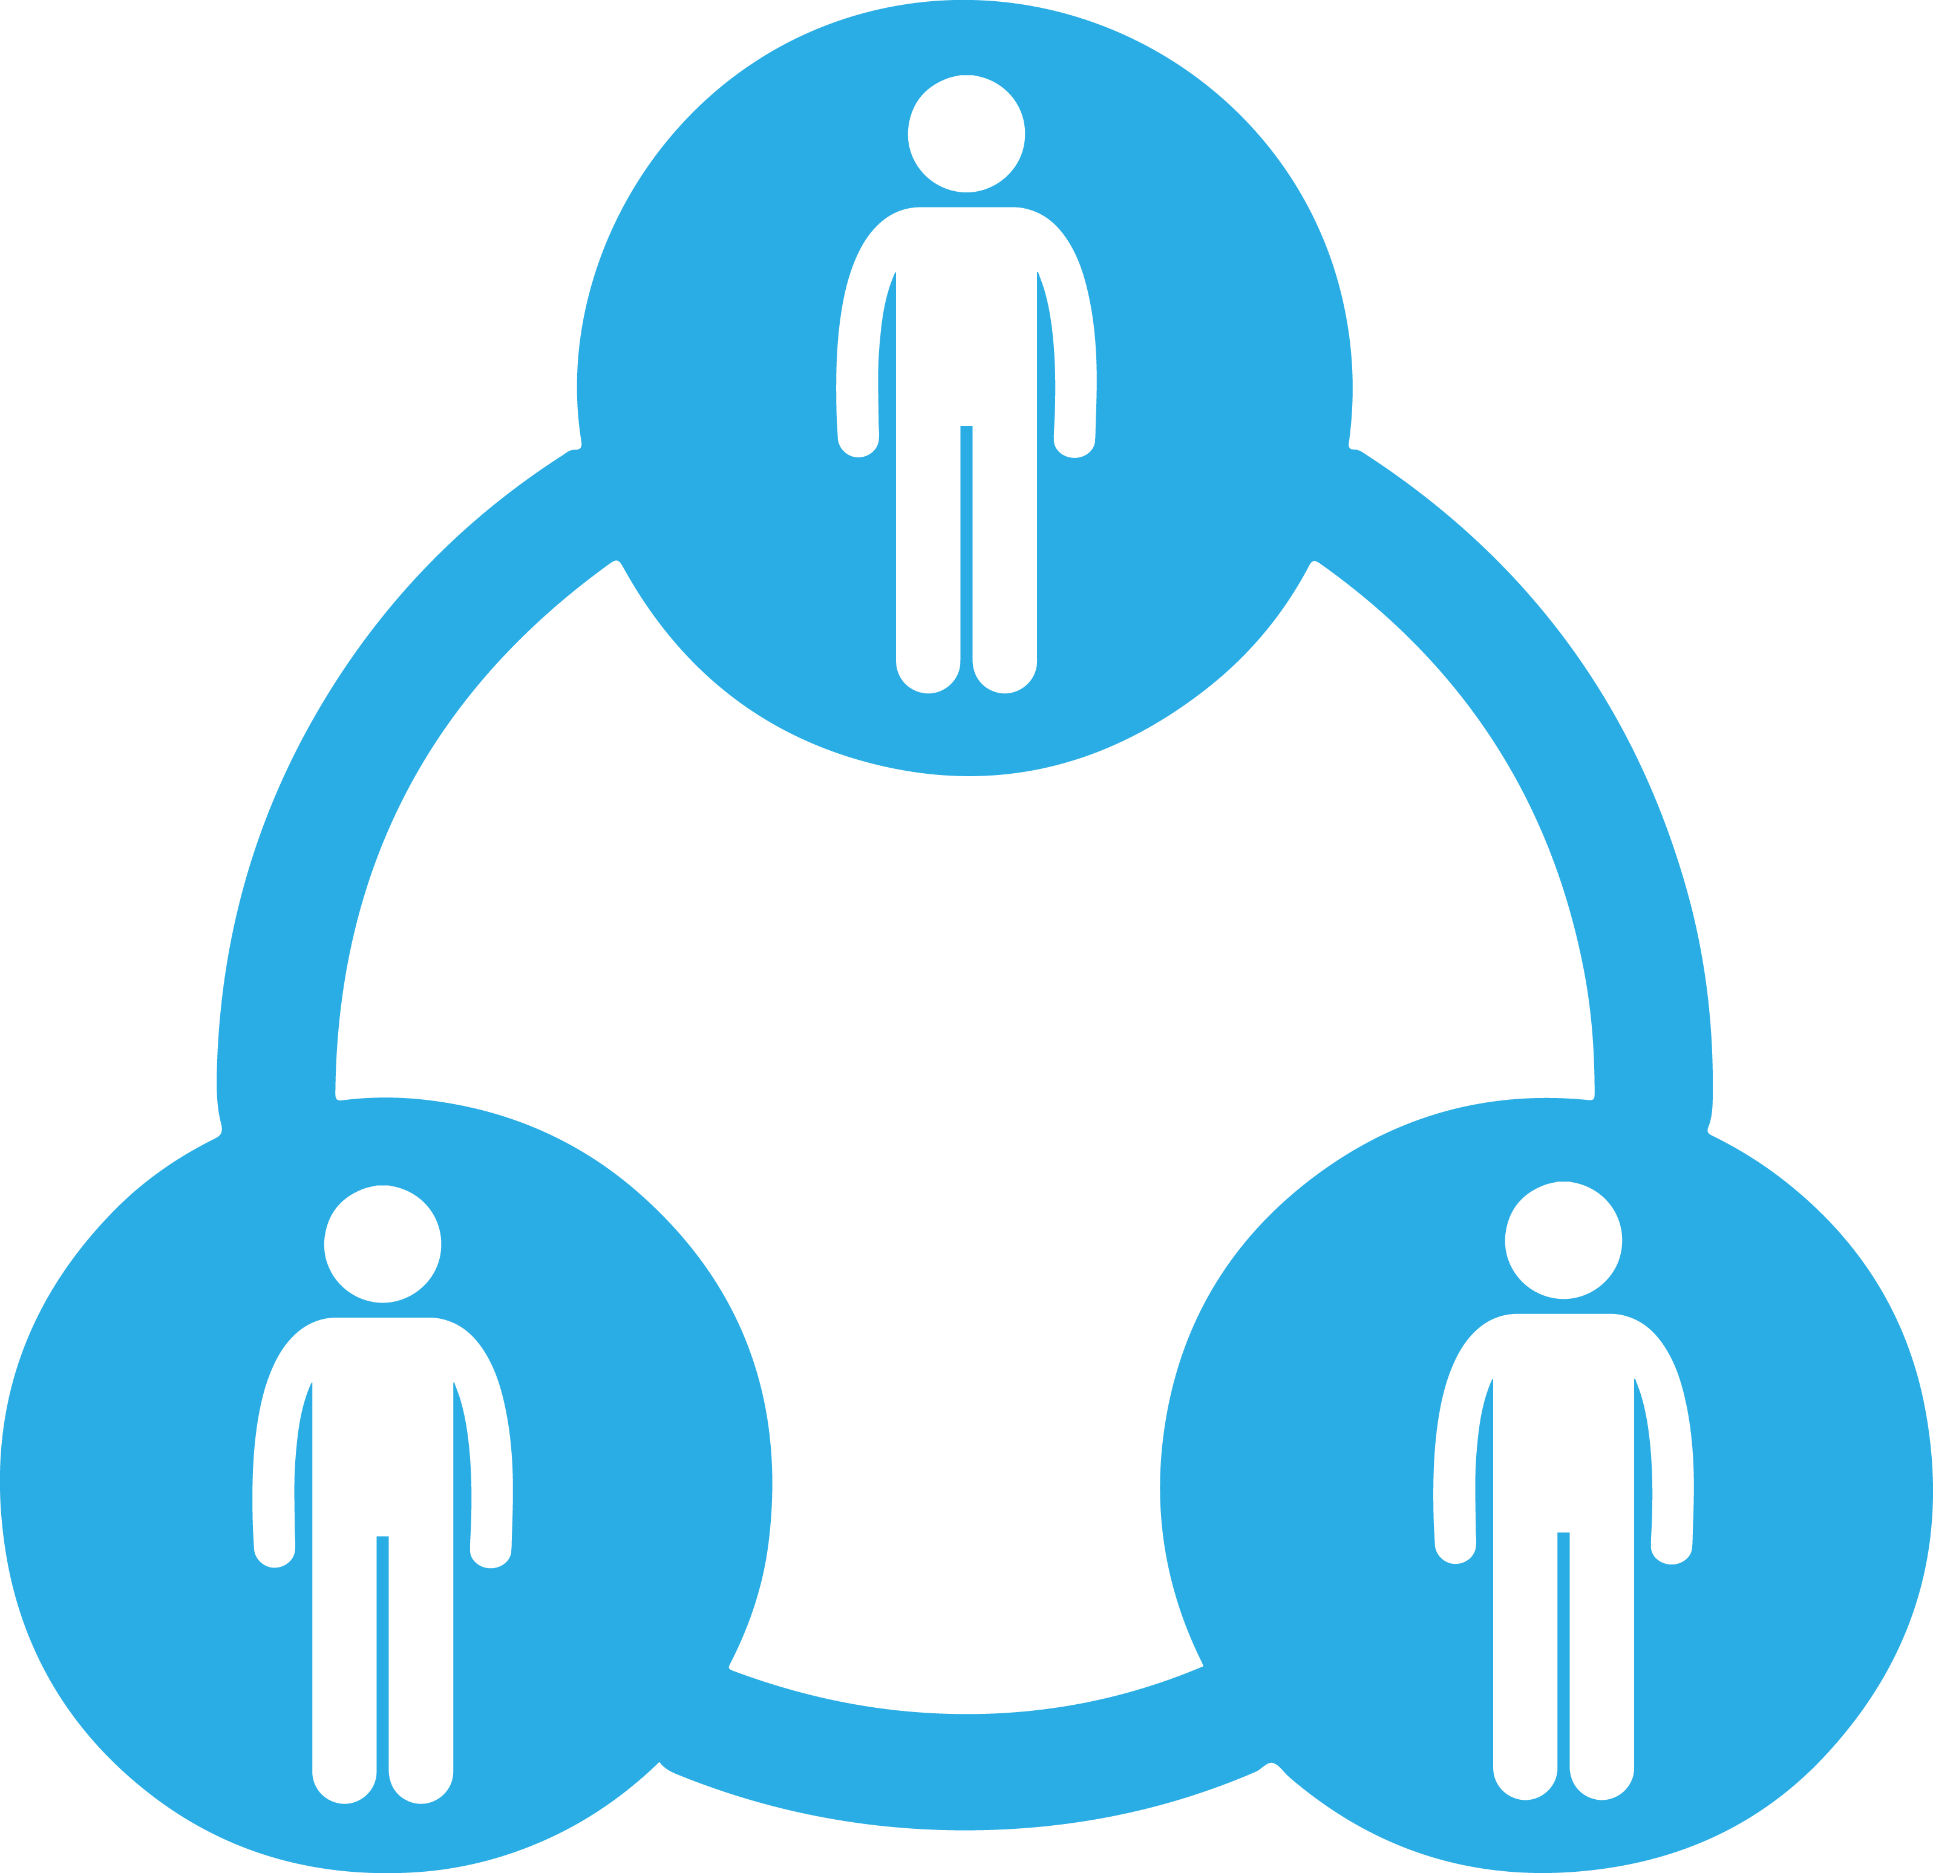
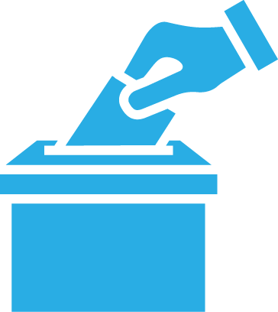
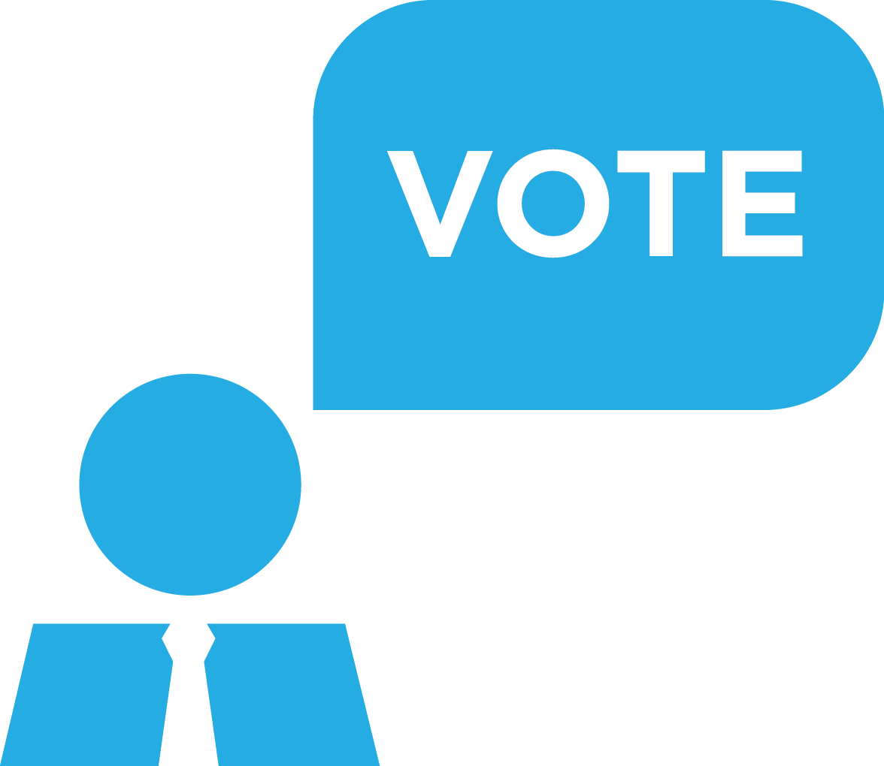
BEYOND STATUTORY RESPONSIBILITIES
Notes:
Language: There are a lot of responsibilities that beyond the legally expected responsibilities of a PC. Precinct Committeepeople are a lot more than just members of their Central Committee, even though that’s important and pretty awesome. You’re also organizers. You talk to voters and build relationships. Sometimes you’ll register new voters, and you’ll keep them informed. Then, when we get to GOTV season, you’ll make sure all of them get to the polls.

Slide 18
TWO PHASES OF ORGANIZATION
BUILDING RELATIONSHIPS
GOTV
Notes:
Language: We can break down organizing into two key components. First, we build relationships with people. We get to know the Democrats in our precinct and build community with them.
Suggested Question: has had a powerful experience talking to other Democrats in their precinct?
Language: Building relationships is about building trust, and that goes both ways. It helps us better serve our neighbors by keeping them informed. It’s also an important way for us to make sure our county party is working toward the issues that Democrats in our county really care about.
But when we get near election day, our motivation flips. That focus changes from building relationships with people, to getting them out to vote – and ideally as early as possible. We’ll rely on those amazing Democrats we’ve met to make a difference with their ballot, and we’ll ask them to volunteer to help the cause by getting involved with GOTV.

Slide 19
BUILDING RELATIONSHIPS
Notes:
Language: There are a lot of ways we can build relationships. Canvassing and phone banking are the most common ways. What are some other ways you’ve built relationships with Democrats in your precinct? (Take 2-3 ideas)

Slide 20
AGENDA
1
Welcome, Introductions, and Overview
2
Responsibilities
3
Organizing My Precinct
4
Getting Out the Vote in My Precinct
5
Debrief

Slide 21
WHAT IS GOTV?
The goal is to have intentional conversations with all Democratic base voters in the precinct and turn them out to vote.
Notes:
Language: It’s September, so we have to talk about GOTV. This is the time we shift from a relationship-focused organizing, to an objective-focused organizing. And that objective is to have intentional conversations with all Democratic base voters in the precinct and turn them out to vote.

Slide 22
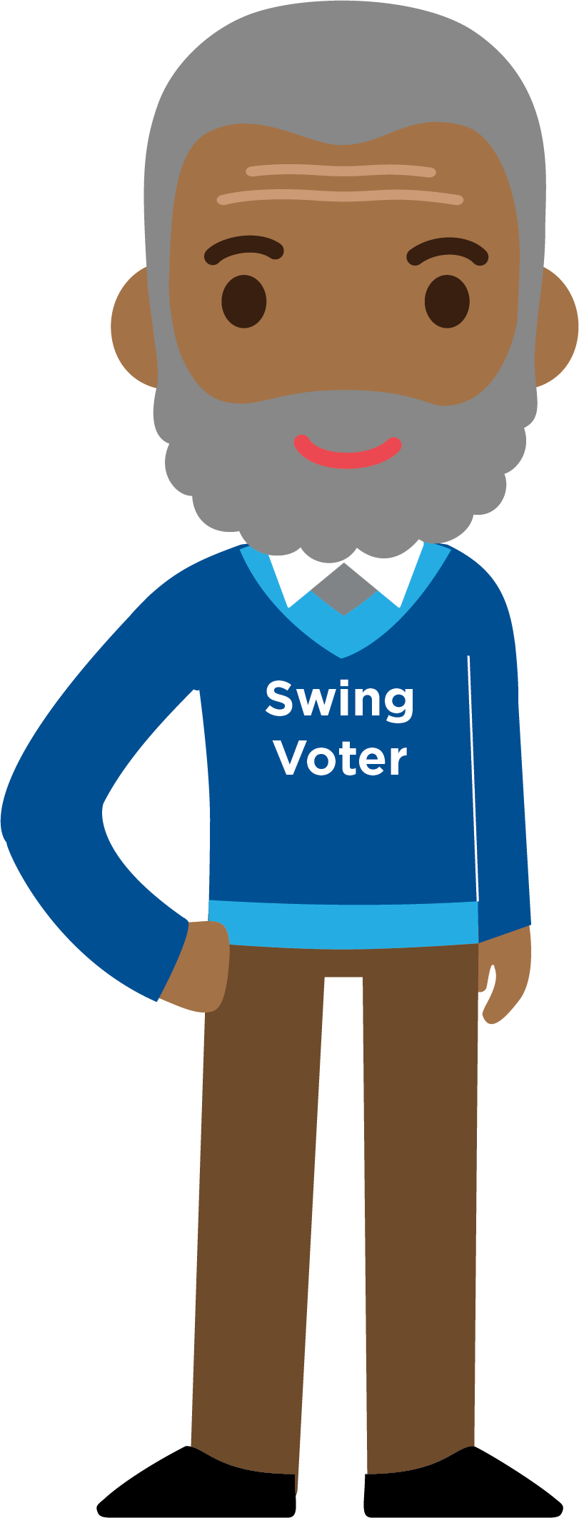
CANDIDATES AND PRECINCT COMMITTEEPEOPLE
PRECINCT COMMITTEEPERSON
CANDIDATE
Notes:
When PCs make sure that Democratic base voters make it to the polls, campaigns can focus their energy on more difficult voters.
Democratic base voters are your lean and strong Democrats – folks who reliably vote and reliably vote in elections.

Slide 23
GOTV IN YOUR PRECINCT
EGOTV
(September 27 - November 2)
- Ensure Democratic voters return Vote by Mail ballots
- Contact Democratic voters and encourage early voting
GOTV
(November 3 - 6)
- Reach every Democratic voter who has not voted
Notes:
Language: We want them to vote as early as possible. Early Get Out the Vote starts on September 27th. From there we have just over five weeks!
The amazing thing is that when we get those Democratic base voters to vote early in-person, or submit a vote by mail ballot as soon as they get it, they will start to come off every campaign’s list. That saves campaigns a lot of time, and let’s them focus on folks who need more motivation.
By the time you get to November 3rd, the real Get Out the Vote program starts. This is fast and furious, knock every door and call every phone number of Democrats who have not voted yet. If you need motivation to push early vote, just remember every person who early votes is only less person you have to track down in the last few days before Election Day.

Slide 24
ELECTION DAY DURING GOTV
Ensure election is being administered fairly and legally
Check off Democratic voters as they vote
Distribute palm cards outside of the polling location
Contact and turn out voters
Notes:
Language: On Election Day, there are a number of responsibilities. We want to be there for our voters, making sure they don’t face any trouble at the polls. We’ll keep track of who has voted to make sure we get every single person to the poll. We’ll hand out palm cards, which are basically a little flier that lists all of the Democratic candidates on the ballot. And as the day goes on, we’ll make sure every single Democrat has actually shown up!

Slide 25
ELECTION DAY ROLES
Get your shoes on,
let’s go vote
Notes:
Language: There are a few key roles on Election Day, and we need people power to make it work. So first of all, make sure you’ve requested that day off work if you are able. As you’re asking others to help out, these are some of the roles you can ask them to help with:
Poll Watchers, or Checkers are volunteers who keep track of voters who come to the polling place throughout Election Day. They are called “Checkers” because they mark off the names of those who have voted on a master lists of the voters in their precinct.
Passers distribute “palm cards” in front of the polling location. Palm cards have the names and office of local Democratic candidates. Passers must stand 100 feet from the polling location (by Illinois law).
Runners are so named because they physically go to the homes of all voters who have not voted and make sure they vote. The Runners’ busiest time is between 5:00pm – 7:00pm. Folks who are not able to canvass can also make phone calls.

Slide 26
AGENDA
1
Welcome, Introductions, and Overview
2
Responsibilities
3
Organizing My Precinct
4
Getting Out the Vote in My Precinct
5
Debrief

Slide 27
TAKEAWAYS
Notes:
Language: What are some things you’ve learned today, or new ideas you’ve had as we’ve talked about those core PC responsibilities today? (Call on 2-3 participants).

Slide 28
ONLINE COURSE SUGGESTIONS
Getting Started as a Precinct Committeeperson
Notes:
Language: While this session is done for today, NDTC has an Online Academy with a range of courses available! You should check out “Getting Started as a Precinct Commiteeperson” and “Finding Volunteers and Other Supporters” for more information!

Slide 29
WHAT IS A PRECINCT COMMITTEEPERSON?
TRAINER NAME
TRAINER EMAIL

Slide 30
Notes:
Title Page – Option 1

