Slide 1
Notes:
Handouts Note: GOTV script, canvassing terminology sheet, sample contact list, sample turf map, and GOTV vote plan sheet.

Slide 2
VOTER CONTACT
Notes:
Update slide with name.
Language: This is your chance to intro the session title and yourself. Give trainees the 2 minute version of who you are and why you are excited to be in the room training. Use this time to establish credibility within the room and set the tone for the session.

Slide 3
AGENDA
1
Welcome, Introductions, and Overview
2
Role in Voter Contact
3
Voter Contact Terminology
4
Talking to Voters
5
Making Vote Plans
6
Connecting Voter Contact and Data
7
Debrief
Notes:
[NOTE]: Walk through the agenda for the session. This exact slide will appear in between sections throughout the entire training deck.

Slide 4
AGENDA
1
Welcome, Introductions, and Overview
2
Role in Voter Contact
3
Voter Contact Terminology
4
Talking to Voters
5
Making Vote Plans
6
Connecting Voter Contact and Data
7
Debrief

Slide 5
ICEBREAKER
Notes:
[LANGUAGE]: What is one word you would use to describe your feelings about talking with voters?
[NOTE]: If there are less than five people in the room, let each participant share a word. If greater than five, ask participants to raise hands, call on the first 5. After you call on a participant, ask for others to raise hands if they agree with the word the participant shared.
[TIME]: This should not take more than 2-3 minutes of your presentation.

Slide 6
OBJECTIVES
Identify the precinct committeeperson’s role within voter turnout
Practice canvassing conversations
Recognize how voter contact and data connect
Notes:
LANGUAGE: Throughout this session we have 3 big objectives we want to accomplish. First, we are going to identify your role within voter turnout. We want you to feel confident with how your role operates within a larger voter turnout operation. Second, we’re going to discuss tried and true methods for get-out-the-vote (GOTV) voter contact and practice these tactics so that you and any of your volunteers are ready to lead those efforts in your precinct. And lastly, we’re going to look at how the voter contact we do connects with the data.

Slide 7
AGENDA
1
Welcome, Introductions, and Overview
2
Role in Voter Contact
3
Voter Contact Terminology
4
Talking to Voters
5
Making Vote Plans
6
Connecting Voter Contact and Data
7
Debrief

Slide 8
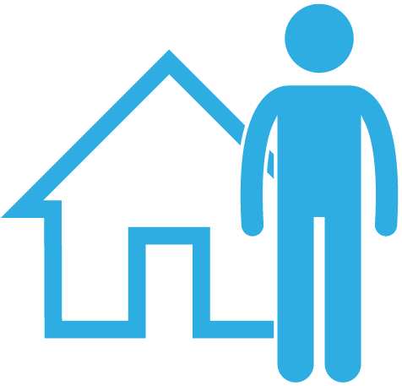
LEADERSHIP WITH VOTER TURNOUT
Individual campaign
VOTER TURNOUT
Statewide coordinated campaign
Precinct committeeperson
Local Democratic Party
Notes:
NOTE: Do not get into the specifics of every single part of voter turnout. Illustrate the importance of the precinct committeeperson.
LANGUAGE: The precinct committeeperson plays a critical role in voter turnout through getting out the voter for base Democratic voters in their precinct, people who the precinct committeeperson has built relationships with throughout the year. The local Democratic Party is generally focused on getting out the Democratic vote with the entire local party’s regional area. Individual campaigns are focused on a particular candidate, and statewide coordinated campaigns are working with candidates to get out the vote for people who support the candidates, which can included voters they worked to persuade.

Slide 9
PRECINCT COMMITTEEPERSON
Build relationships
Motivate Democratic base voters
Sustain connections between elections
Notes:
LANGUAGE: Recall the information from the training earlier in the day. Your work is so important because during an election year, you are motivating Democratic base voters. In off-years, you are continuing to build relationships and understand your base voters’ concerns in your precinct and sustain these connections between elections.
NOTE: You can share an example of relationship building such as having a coffee and issues night, having a local elected official meet-and-greet, or listening session during a non-election year.

Slide 10
AGENDA
1
Welcome, Introductions, and Overview
2
Role in Voter Contact
3
Voter Contact Terminology
4
Talking to Voters
5
Making Vote Plans
6
Connecting Voter Contact and Data
7
Debrief
Notes:
LANGUAGE: To learn about talking to voters, we want to share some terminology. Also, there is a handout in your folders that features terminology and definitions around voter contact.

Slide 11
PHASES
Persuasion
Start of Voter Contact
EGOTV
Begins September 27
GOTV
November 3-6
Election Day November 6
*Voting Begins*
Notes:
LANGUAGE: Part of your work is turning out the Democratic base in your precinct! Many candidates and coordinated campaigns have heavy focus points during the persuasion phase of an election year to get to their “win number”.
Early GOTV (or EGOTV) begins on September 27, and vote by mail requests can be submitted starting on August 8. (Asks for raised hands): How many of you have participated in any EGOTV effort?
GOTV is the last four days of the election, that Saturday through Election Day on Tuesday. (Asks for raised hands): How many of you have every participated in GOTV? (Pause). For how many of you will this be your first time doing GOTV efforts? Great! It’s such an exciting time!
Finally, Election Day is November 6. (Asks for raised hands): How many of you are excited about getting out the Democratic vote in your precinct on Election Day this year?!

Slide 12
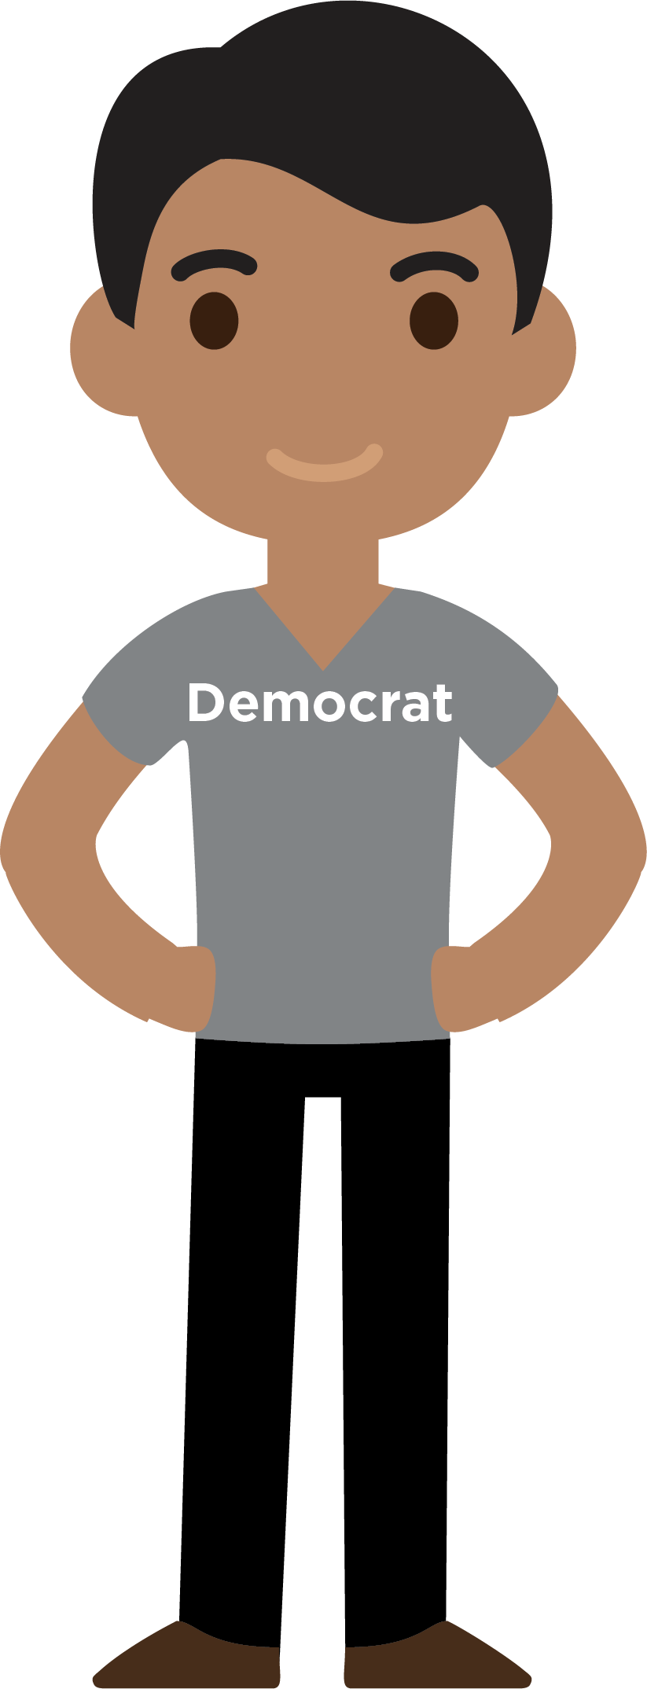
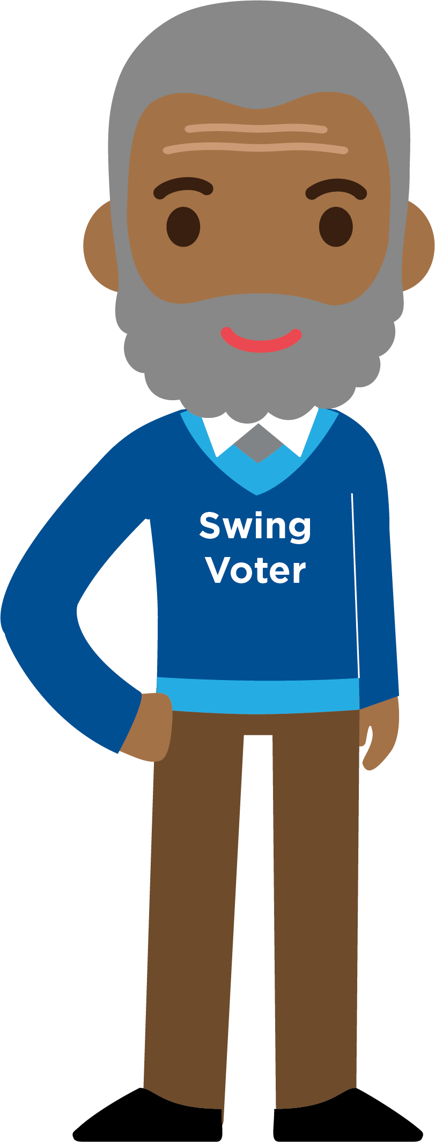
TARGETING VOTERS IN THE GOTV UNIVERSE
PRECINCT COMMITTEEPERSON
CANDIDATE
Notes:
ASK LANGUAGE: How does targeting voters look differently for precinct committeepeople and candidates? (Get 1-2 answers from the participants, checking for retention of this concept).
REPEAT LANGUAGE: The precinct committeeperson focuses on turning out Democratic base voters, while candidates are also turning out the swing voters who they have gotten to commit to voting for them.

Slide 13
CANVASSING
This is the most effective field tactic you can use!
Best use of volunteer time
Best conversations voters will remember
Notes:
LANGUAGE: In order to reach these voters to make sure they vote, we have to go door-to-door and canvass, meeting people and having memorable conversations.

Slide 14
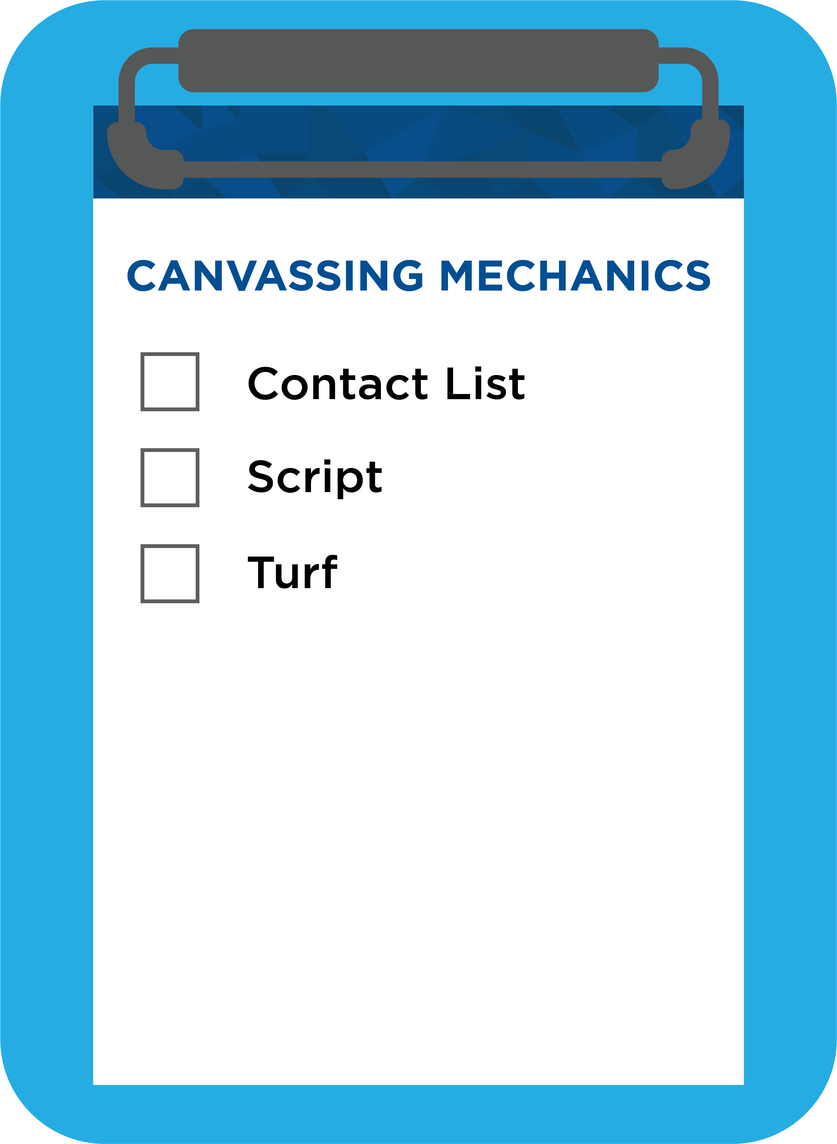
CANVASSING MECHANICS
Notes:
LANGUAGE: When you go canvassing, you generally will have a clipboard. Then, if you look in your folders, you will see an example of a script that is used during EGOTV and GOTV canvassing. You will know which houses to go to because you’ll have a contact list of targeted base Democratic voters, either created through a Votebuilder (or VAN) or a simple spreadsheet. You can connect with your county or local Democratic Party regarding these lists. The “turf” is the map generally with dots indicating the houses that correlates with the contact list. It provides you a visual way to efficiently map your route to talk to Democrats.

Slide 15
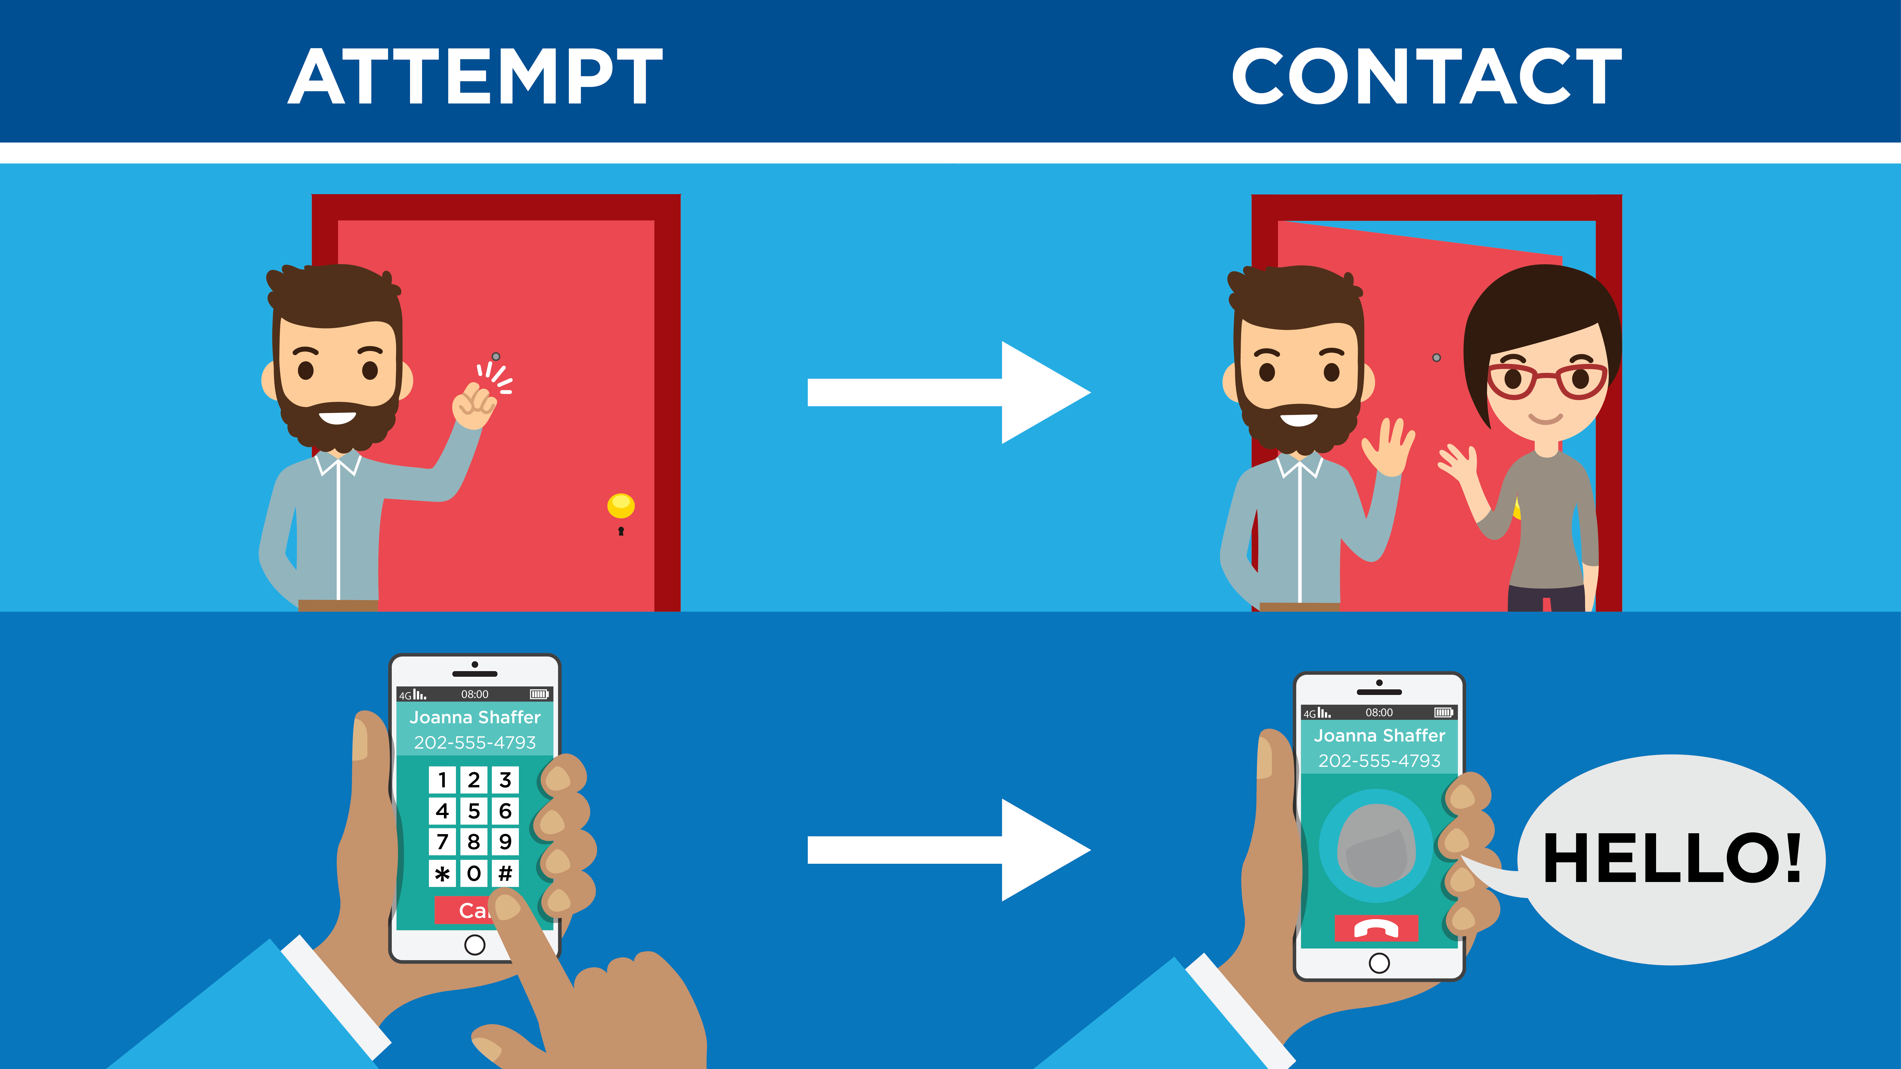
CONTACT RATES
Notes:
NOTE: Explain an attempt and contact.
[LANGUAGE]: Most likely, you may have more attempts than contacts during a round of canvassing, which is why it is so important to build multiple rounds of canvassing to ensure there are conversations with each voter. During a contact, you or your volunteer will be having a conversation with the voter.
Contact rates will differ in each community and precinct.
[PAUSE and ASK]: Does anyone have any questions on main terminology?

Slide 16
AGENDA
1
Welcome, Introductions, and Overview
2
Role in Voter Contact
3
Voter Contact Terminology
4
Talking to Voters
5
Making Vote Plans
6
Connecting Voter Contact and Data
7
Debrief

Slide 17
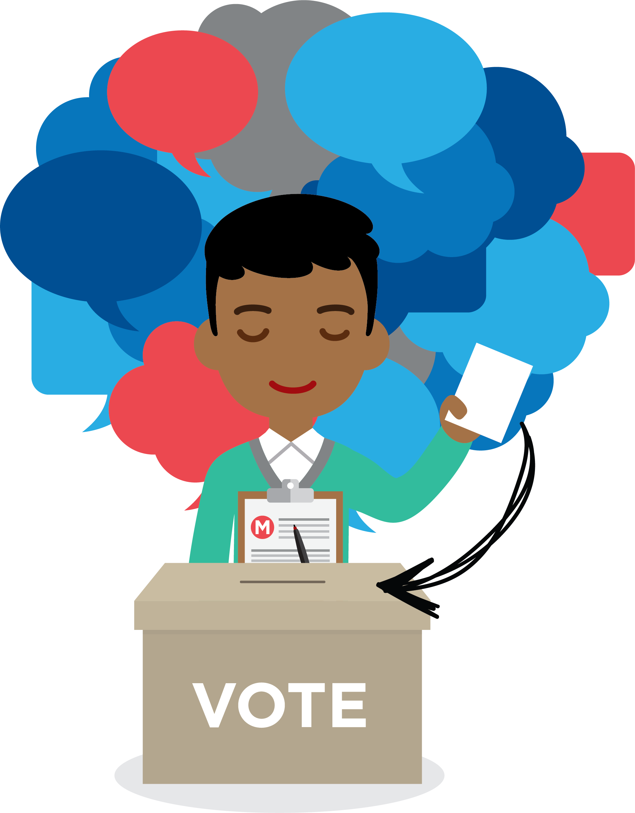
GOTV CONVERSATIONS RESULT IN TURNOUT
Notes:
LANGUAGE: All of these contacts, leading to conversations, result in voter turnout. When we have conversations that are specific, memorable, and intentional, we turn out people to vote. In a moment, we will walk through a script, but in these conversations, a canvasser shares why they care about the election and can listen to why the election is important to the voter (and remind them why the election is important to them). The canvasser is also being specific about information and the questions that are asked during a GOTV conversation.

Slide 18
GOTV CONVERSATION FLOW
Introduce Yourself
Confirm Support
Encourage and Motivate
Make a Plan
Notes:
NOTE: Reference the script in the handout folder. Facilitator should quickly reference the four parts of a GOTV conversation flow, and then share an example of a memorable GOTV conversation they have had (a specific detail that the voter shared) and what that felt like. Then, move to the audience participation phase of facilitation to collaborate with them (“we do together”).
[ASK]: Ask for a volunteer to be the voter and the facilitator acts as a canvasser to scaffold what a GOTV conversation looks and sounds like. Prompt this volunteer to note that they are planning to vote in the election (you are not needing to persuade this voter in this example).
SPECIFIC LANGUAGE: (Follow the script/similar language, and walk through each of the questions.)
*Knock at the door*
Hello! May I please speak with _____? [Confirm they are the voter on the contact list].
I’m your precinct committeeperson in ________. Thank you for being a reliable voter in the past. I’ve been talking to our neighbors, and everyone is voting. It’s an exciting election and every vote counts! Are you planning to vote?
[YES] That’s great! I’m so glad that you’re planning to vote. Voter turnout is predicted to be high this year, so your vote is especially important.
Your polling location is at ____________ (Polling Location). Do you know where that is?
Ask the voter and write responses on voter contact sheet.
The polls will be open from ____________ (poll opening time to poll closing time) on Election Day, Tuesday, November 6, 2018.
Or you can vote early in person beginning September 27, 2018.
Ask: What time and day (during EGOTV)/ time (Election Day) are you planning to go vote?
[NOTE: Get a specific time and day to record in your contact list].
Ask: Before you go to vote, where are you coming from?
Ask: How are you going to get there (walking, cycling, using public transit, driving)?
Ask: How long will it take to get there, and what route do you usually take?
[NOTE: If coming from work or somewhere far away, clarify how long it takes for them to arrive.]
Ask: Who are you bringing with you to go vote?
[NOTE: Ask the voter if they want to send out a calendar invite to anyone and place the event in their mobile or paper planner.]
After confirming all the above details, ask: How do you plan on letting everyone know you voted and encourage others to vote?
[NOTE: Example can be posting a selfie of the voter with an ‘I voted’ sticker].
Your vote will make SUCH a difference! It’s an exciting race where every vote counts. I’ve been talking to our neighbors, and everyone is voting!
I really appreciate your commitment to go vote on [date] at [time] at [polling place]. You’re going [before/after ___ event] with [people they’re voting with]. I know your friends will also love seeing that you voted by [how they plan to share that they voted]!
[NOTE: It is very important to repeat back their voting plan to them and ensure you have recorded the information in your contact list].
Thank you for your commitment to vote!

Slide 19
AGENDA
1
Welcome, Introductions, and Overview
2
Role in Voter Contact
3
Voter Contact Terminology
4
Talking to Voters
5
Making Vote Plans
6
Connecting Voter Contact and Data
7
Debrief
Notes:
[LANGUAGE]: Now that we’ve seen what a GOTV sounds and looks like, let’s unpack each of the questions to understand why the details matter.

Slide 20
EDUCATING VOTERS
Voting is easy!
Your voting location is [LOCATION]
All you need to do to vote is [REQUIREMENTS]
Polls are open from [TIME to TIME]
Notes:
NOTE: Remind audience that we have GOTV conversations to motivate and educate voters with the most essential information at the top of the conversation.
ASK: Why do we have GOTV conversations? (Check for retention with motivating and educating voters).

Slide 21
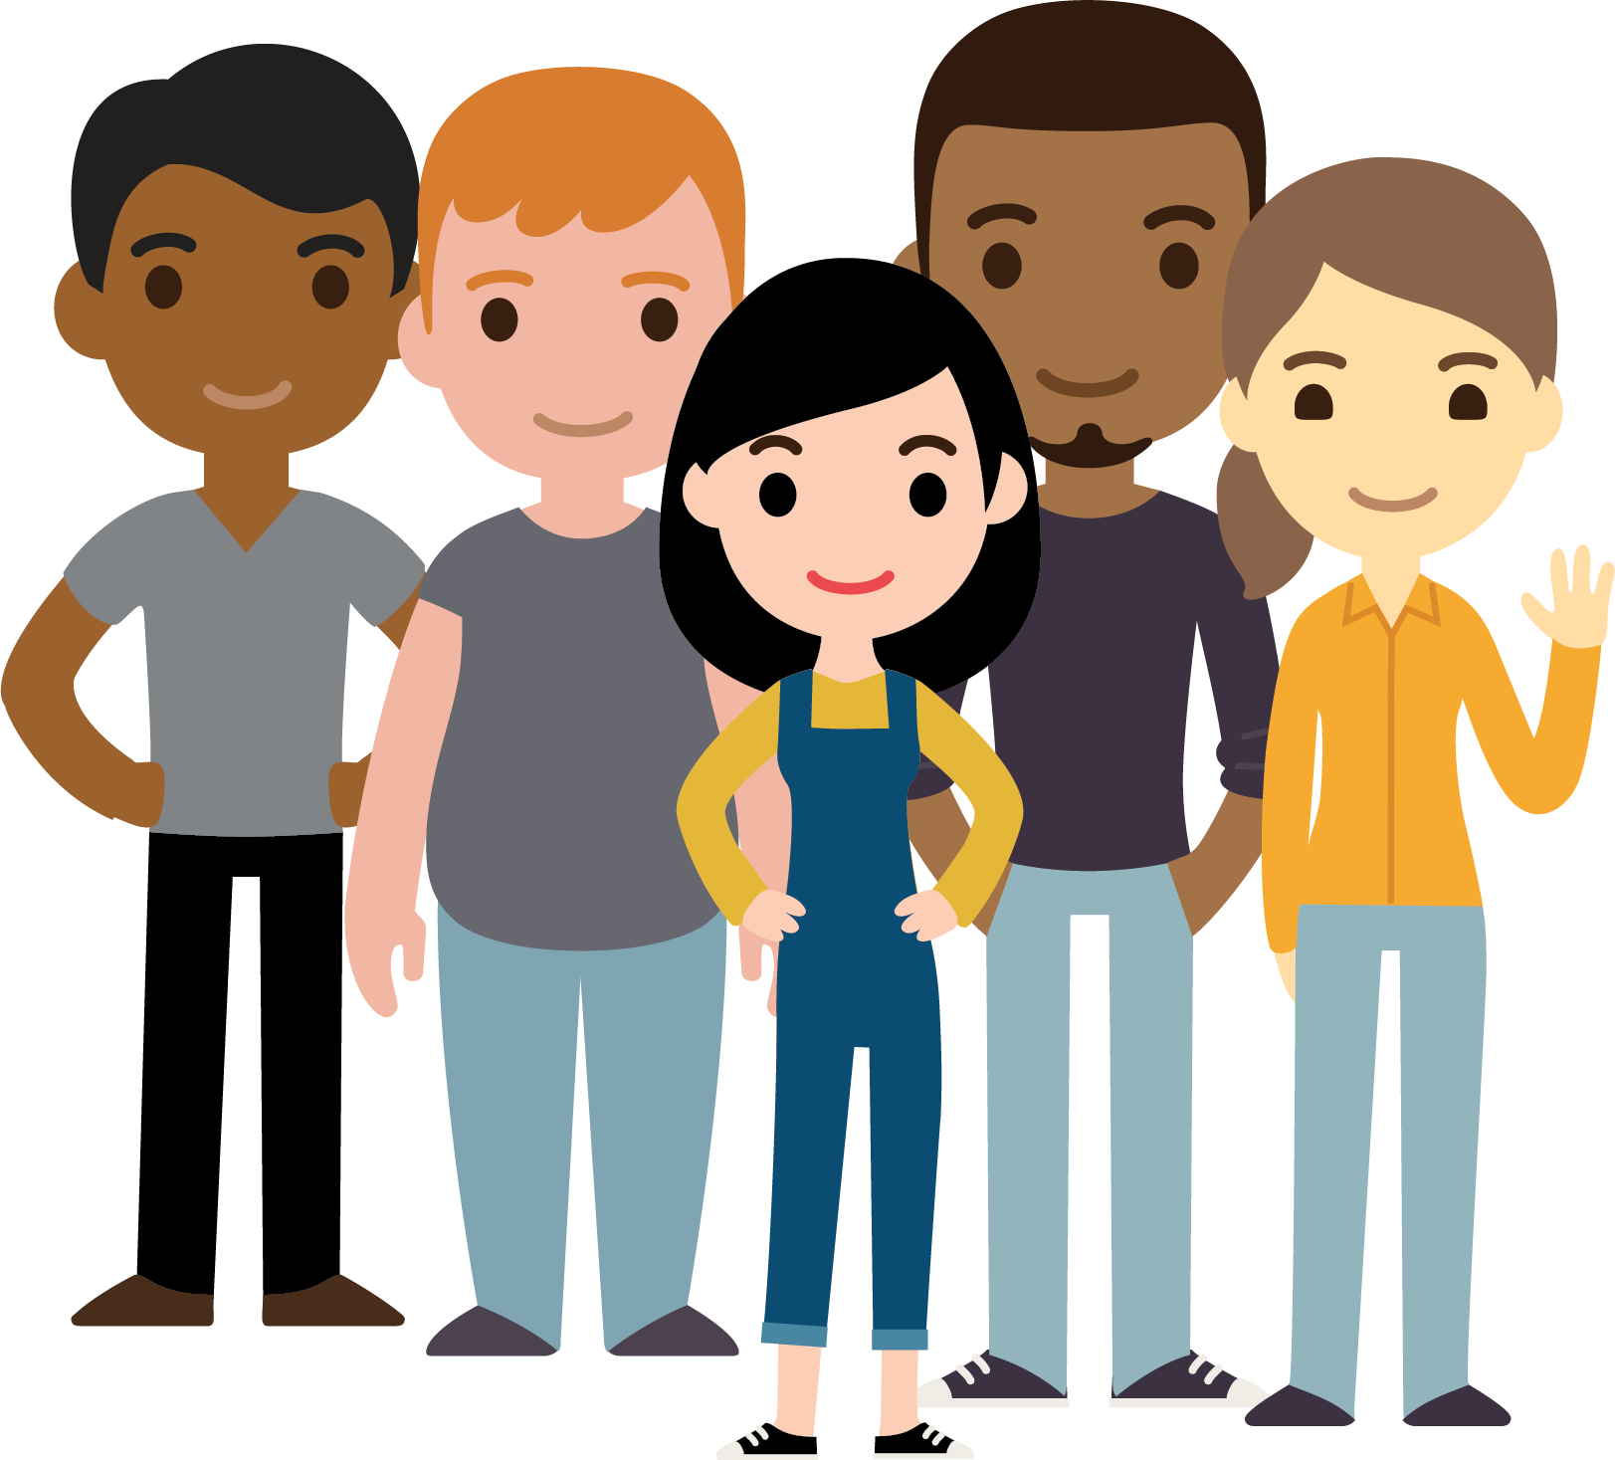
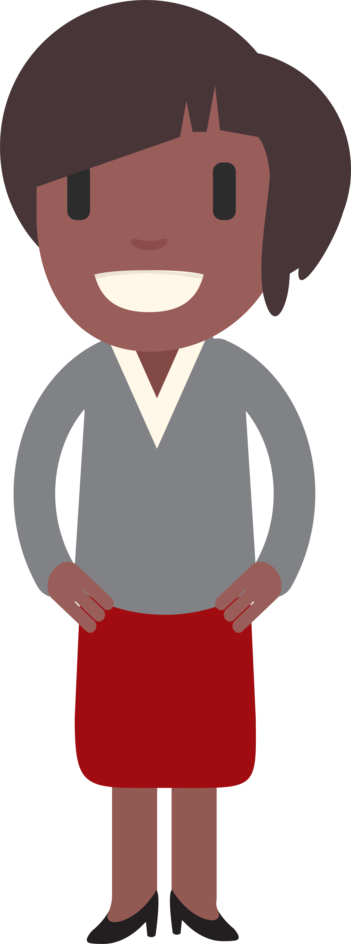
MAKING A VOTE PLAN
I’ve been talking to our neighbors, and everyone is voting!
Notes:
LANGUAGE: You want voters to know and feel that they are part of something bigger! They are joining others in their community to vote. With the first step of making a vote plan, you apply social pressure through sharing that neighbors/ the precinct is voting. You share with them that you know that they are a reliable voter who has supported Democrats in the past. You also share that voting is EASY!
[NOTE]: It is important to note to the audience to never state that voting is “hard” or that “lines can be long” at any point during the day. Additionally, do not note that a voter should vote because voter turnout “could be low.” We want to encourage our audience to know that they need to motivate and encourage voters at the door.

Slide 22
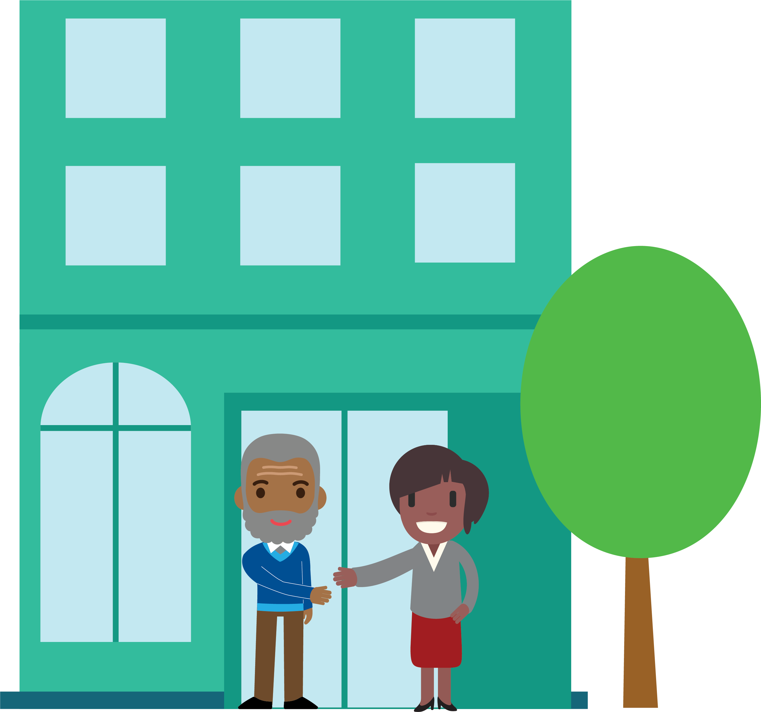
MAKING A VOTE PLAN
Do you know where your polling location is?
Notes:
LANGUAGE: Ask the voter, “Do you know where your polling location is?” You also need to confirm that the voter knows the name of the location and can share a general direction of where it is. Repeat the polling location. If this is your polling location, you can share that, too! This question is important especially if a polling location changed or if the voter had recently moved to your precinct.

Slide 23
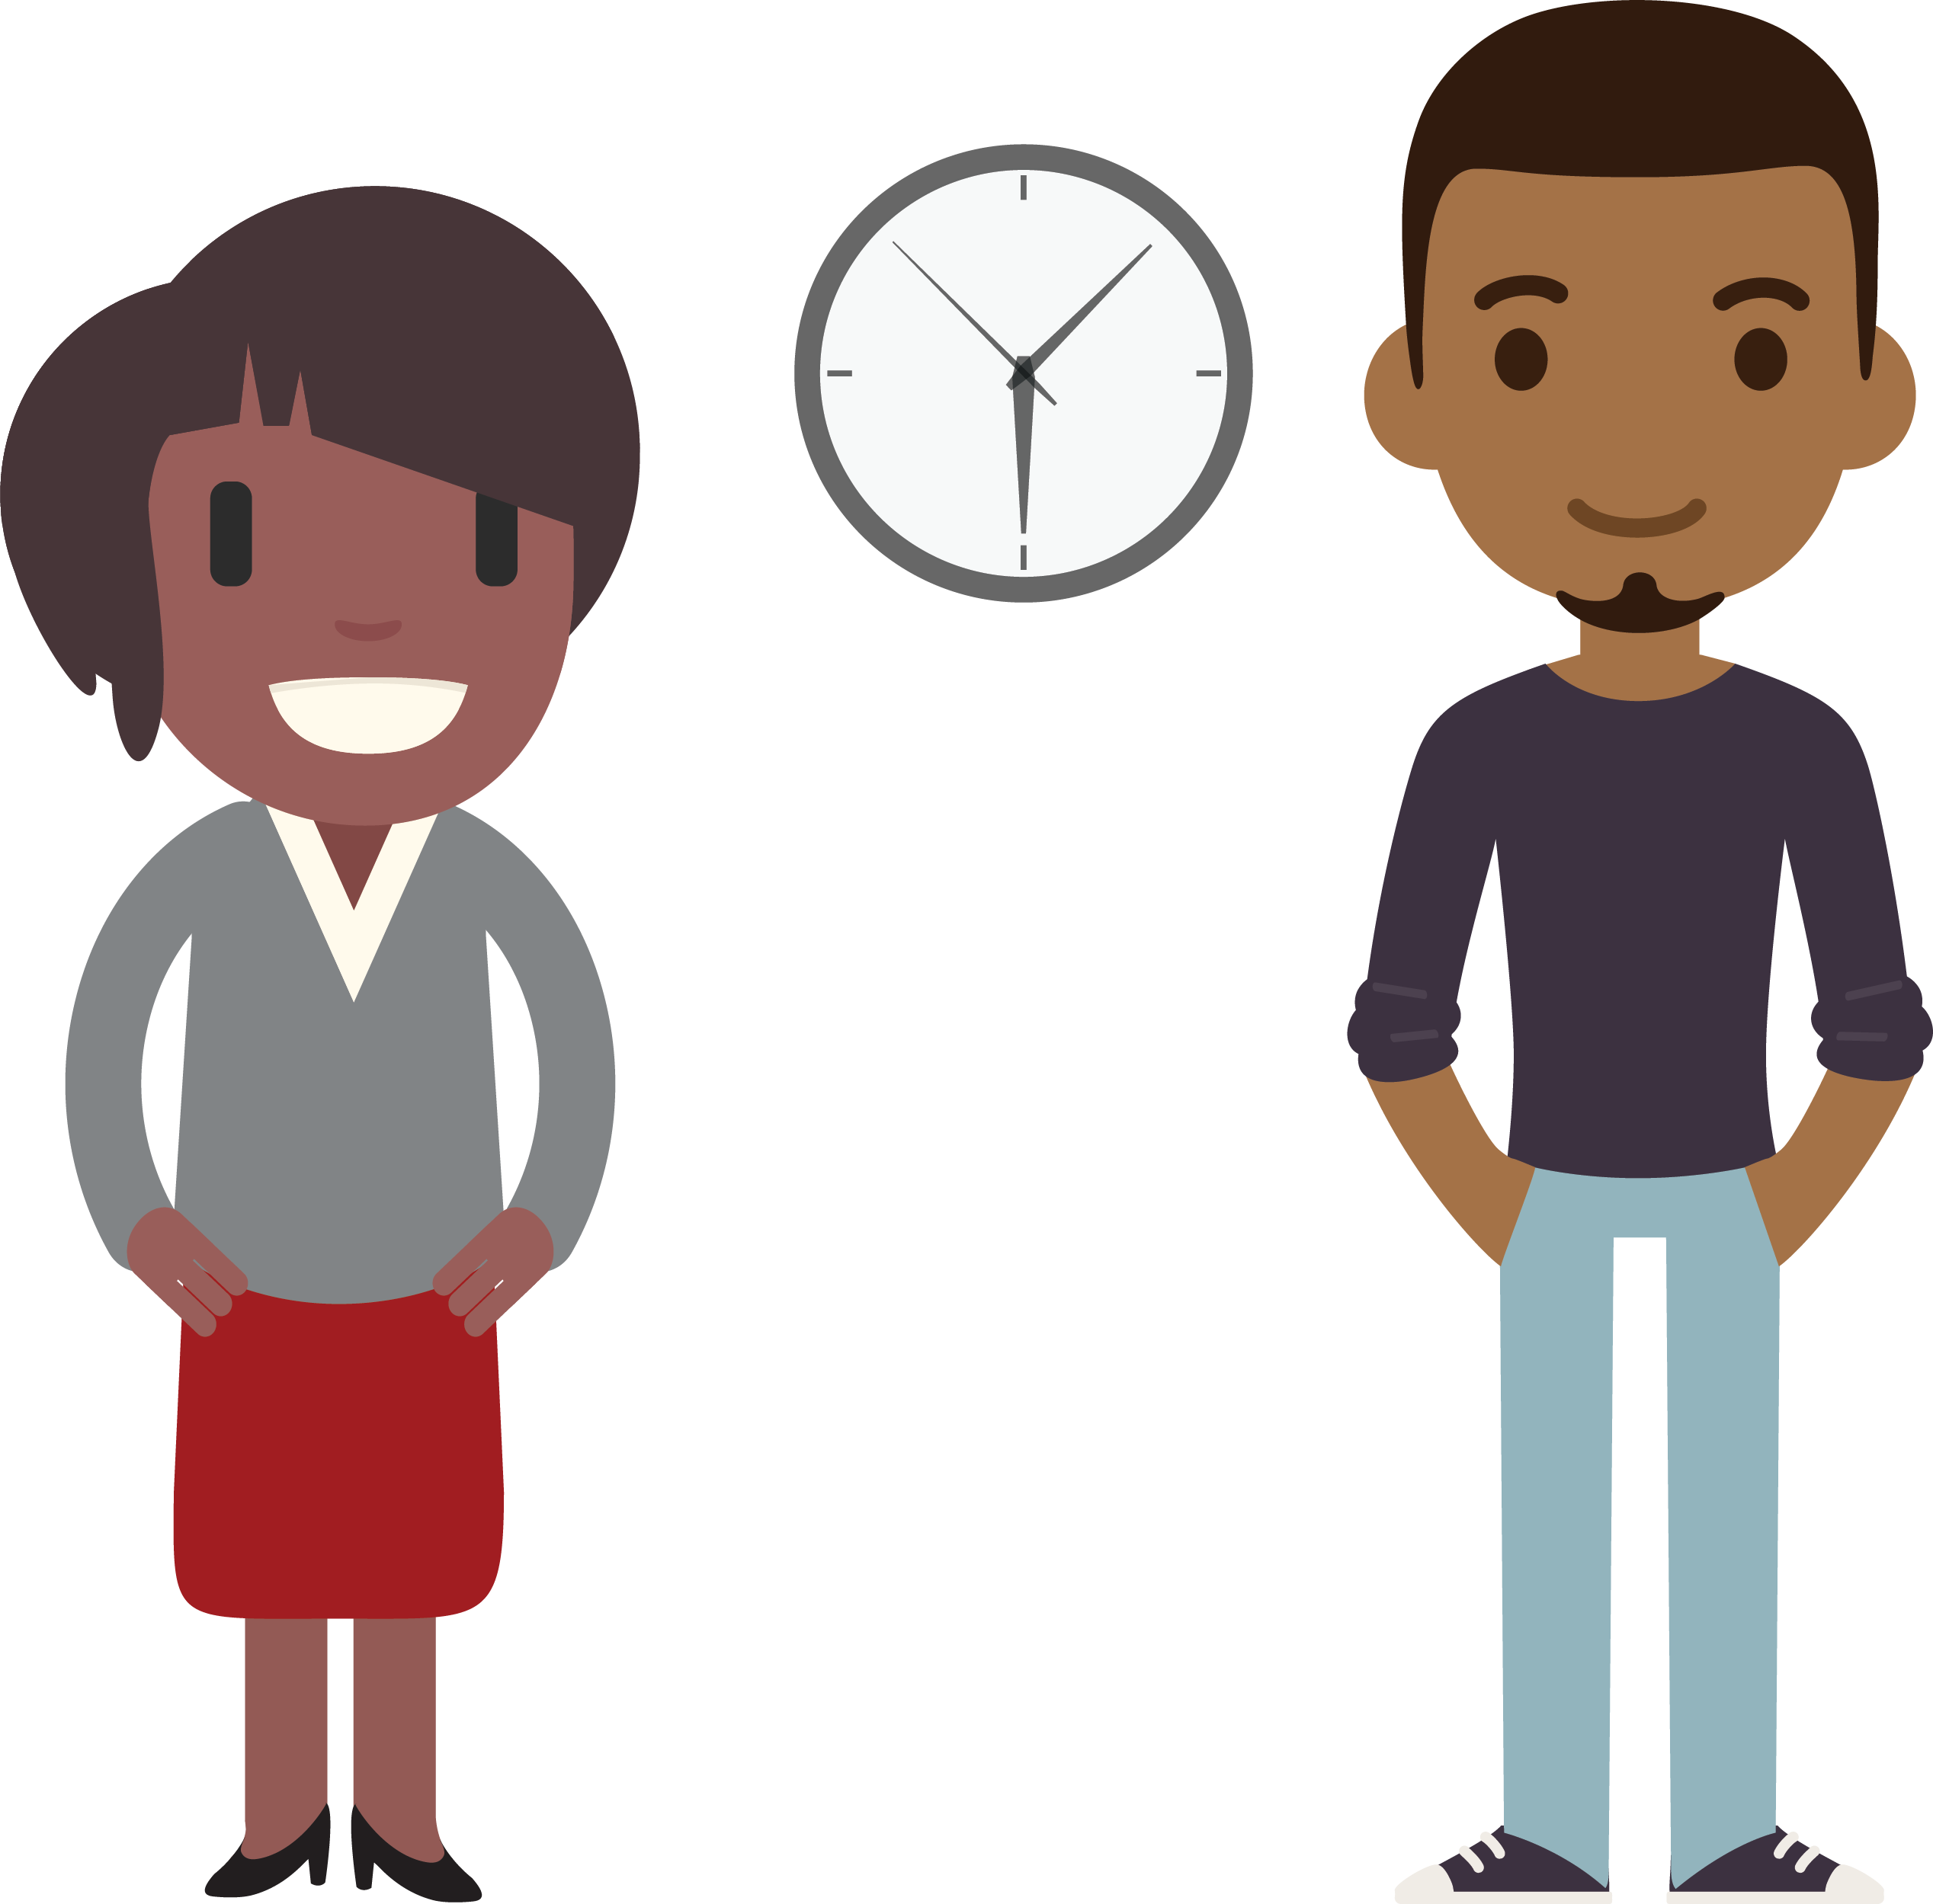
MAKING A VOTE PLAN
What day and time are you planning to go during early voting?
9:00 AM
Notes:
LANGUAGE: Ask the voter, “What day and time are you planning to go during early voting?” Be assumptive with early voting, and if they are insistent with voting on Tuesday, Election Day, definitely get the time that they are voting. Make a note on your contact list.

Slide 24
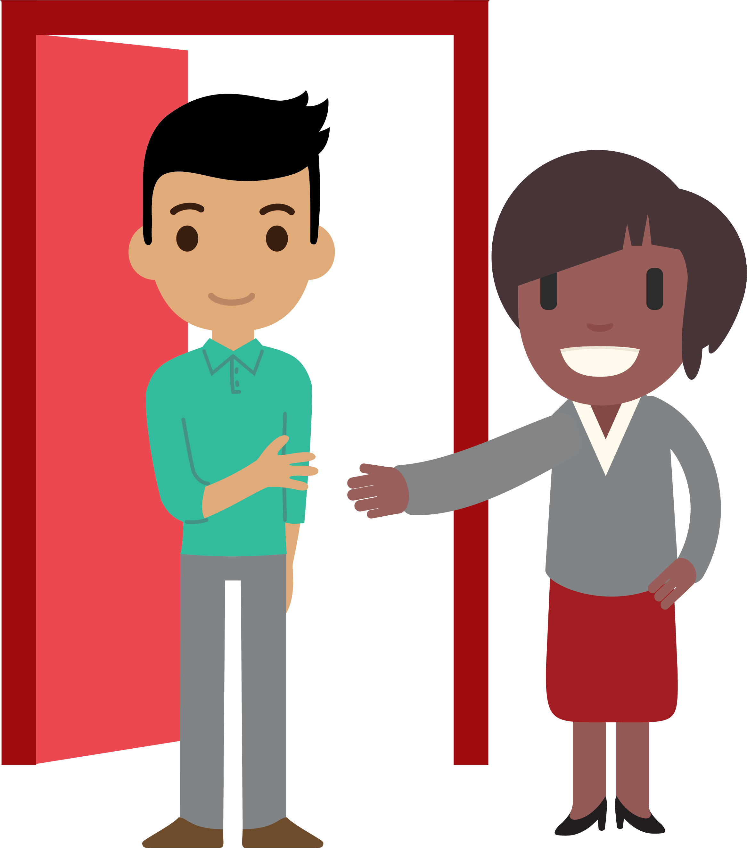
MAKING A VOTE PLAN
Where will you be coming from on Election Day?
Notes:
LANGUAGE: Ask the voter, “Where will you be coming from on Election Day?” With this question, you are helping the voter think through the logistics of their actual day to ensure that their plan will be successful.

Slide 25
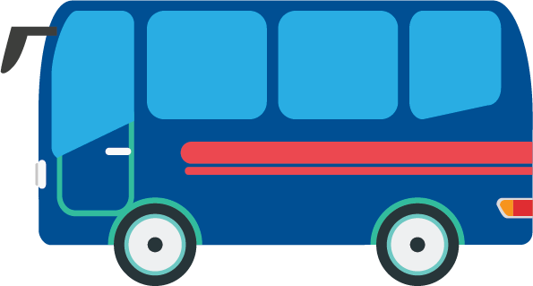
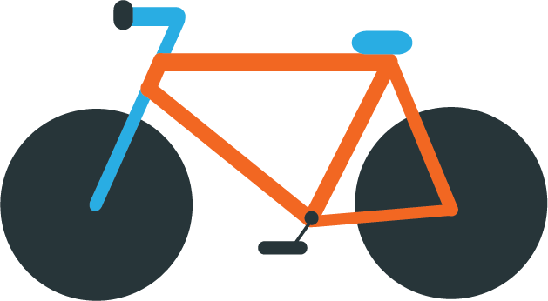
MAKING A VOTE PLAN
How are you going to get there?
Notes:
LANGUAGE: Ask the voter “How are you going to get there?” With this question, you’re getting their mode of transit, how long it will take to get from that place to the polling location, and a general route. You are helping them think through the timing of their transit in the midst of their busy day. If possible, suggest that they go first thing in the morning on Election Day so that they can wear their sticker around and encourages others to vote all day!

Slide 26
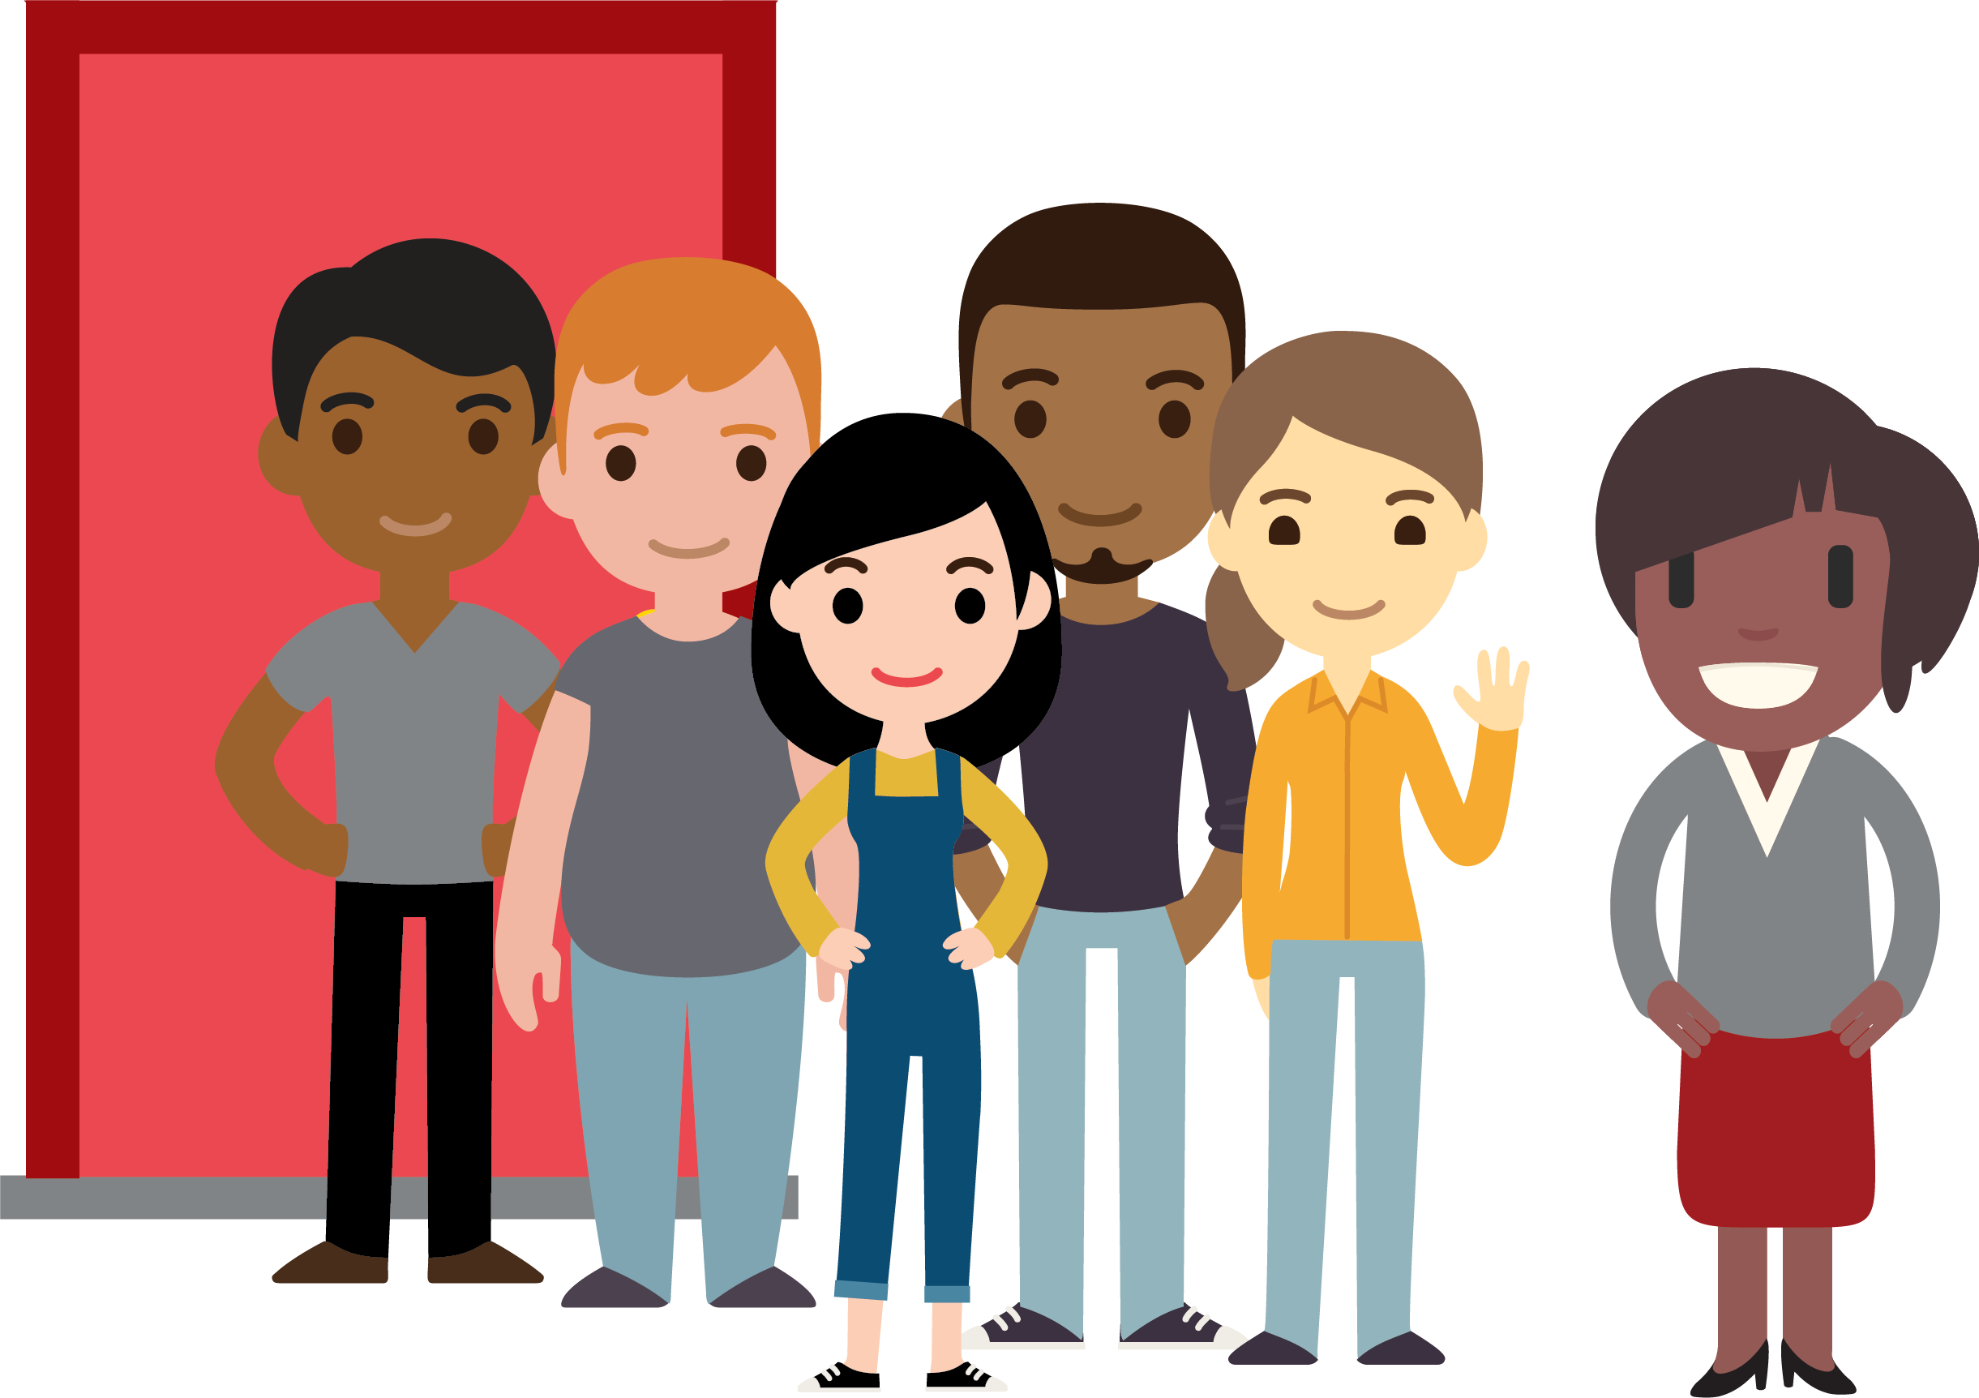
MAKING A VOTE PLAN
Who are you bringing with you to go vote?
Notes:
LANGUAGE: Ask the voter, “Who are you bringing with you to vote?” The more we can empower the voter to encourage others the vote, this has a ripple effect in voter turnout. You can even encourage the voter to (of course) make voting an event in their phone or paper calendar, and invite others to the event right then and there!
[NOTE]: Share something fun and creative that you have done with voting with friends or bringing people to vote with you in the past, especially with early voting!

Slide 27
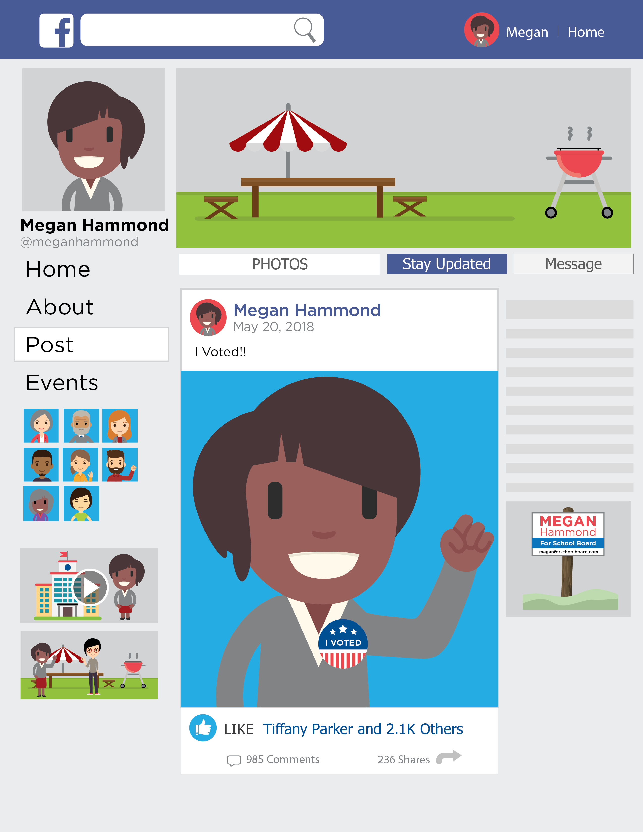
MAKING A VOTE PLAN
Notes:
LANGUAGE: After confirming all the above details, ask: “How do you plan on letting everyone know you voted and encourage others to vote?” Share with them the idea of sharing a photo of themselves wearing their “I voted!” stickers on social media sites, texting friends a photo, or calling their friends to make sure that they vote, too, because everyone is voting this year! This is a nice question to encourage them to motivate others as well.
[NOTE]: Share with the audience one thing you do to let others know that you voted in an election!

Slide 28
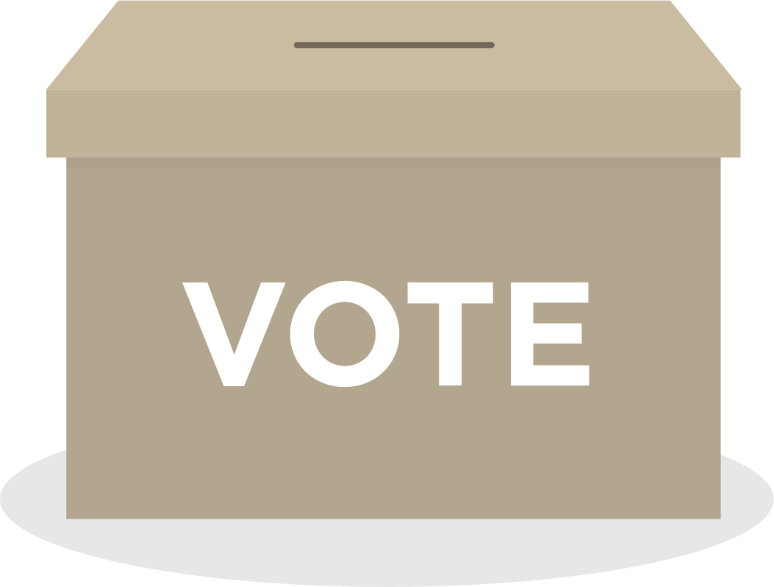
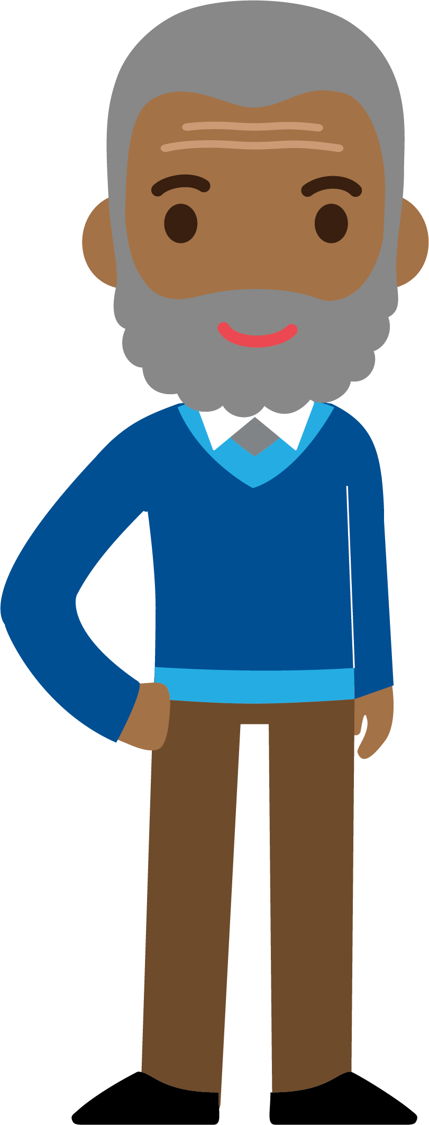
CONCLUDING MAKING A VOTE PLAN
Vote for
Democrats!
Your vote will make a difference! Thank you for your commitment to vote!

Slide 29
Practice with a Partner!
Notes:
Note: This practice session lasts for 20 minutes and features 2 different activities.
Facilitator Language: First I shared an example of a GOTV conversation I’ve had, then we practiced with a volunteer from the audience, we walked through the script in detail, and now we’re ready to practice! Make sure you have your script from your folder. Feel comfortable with making it your own and in your voice, but it is a helpful guide for remembering all the questions to walk a voter through their vote plan.
[Part One Activity, 8-10 minutes] I want you to find a partner and only ask the set of questions with making a vote plan, and for this first round, the voter is someone who wants to vote. This will help us become familiar with the flow of questions. Partner 1 will ask the questions, and partner 2 will provide brief feedback within four-five minutes. Then, Partner 2 will ask the questions, and partner 1 will give feedback. I will let you know when to switch!
[Ask]: In one word, how did asking the questions feel? (Call on 2-3 people, and ask people to raise hands or indicate if they felt that same adjective).
[Partner Activity 2]: Now that we’re feeling confident with the flow of questions, we want to practice the whole conversation. Find a different partner this time, and walk through the entire script, and the voter can be someone who does want to vote and does not necessarily need convincing. Partner 1 will practice the script with Partner 2 as the voter, and Partner 2 will provide two minutes of feedback on language and details. Partner 2 will practice the script with Partner 1 as the voter, and Partner 1 will provide two minutes of feedback on language and details.

Slide 30
TAKEAWAYS
Notes:
LANGUAGE: We just practiced multiple rounds of GOTV conversations! How did it feel to work through the questions, and what did you learn? (Call on 2-3 audience members). Remember that having these conversations with people in your precinct is so important with turning them out to vote!

Slide 31
AGENDA
1
Welcome, Introductions, and Overview
2
Role in Voter Contact
3
Voter Contact Terminology
4
Talking to Voters
5
Making Vote Plans
6
Connecting Voter Contact and Data
7
Debrief
Notes:
LANGUAGE: Now, in those conversations, we get a lot of information! Let’s look at how voter contact conversations and data connect.

Slide 32
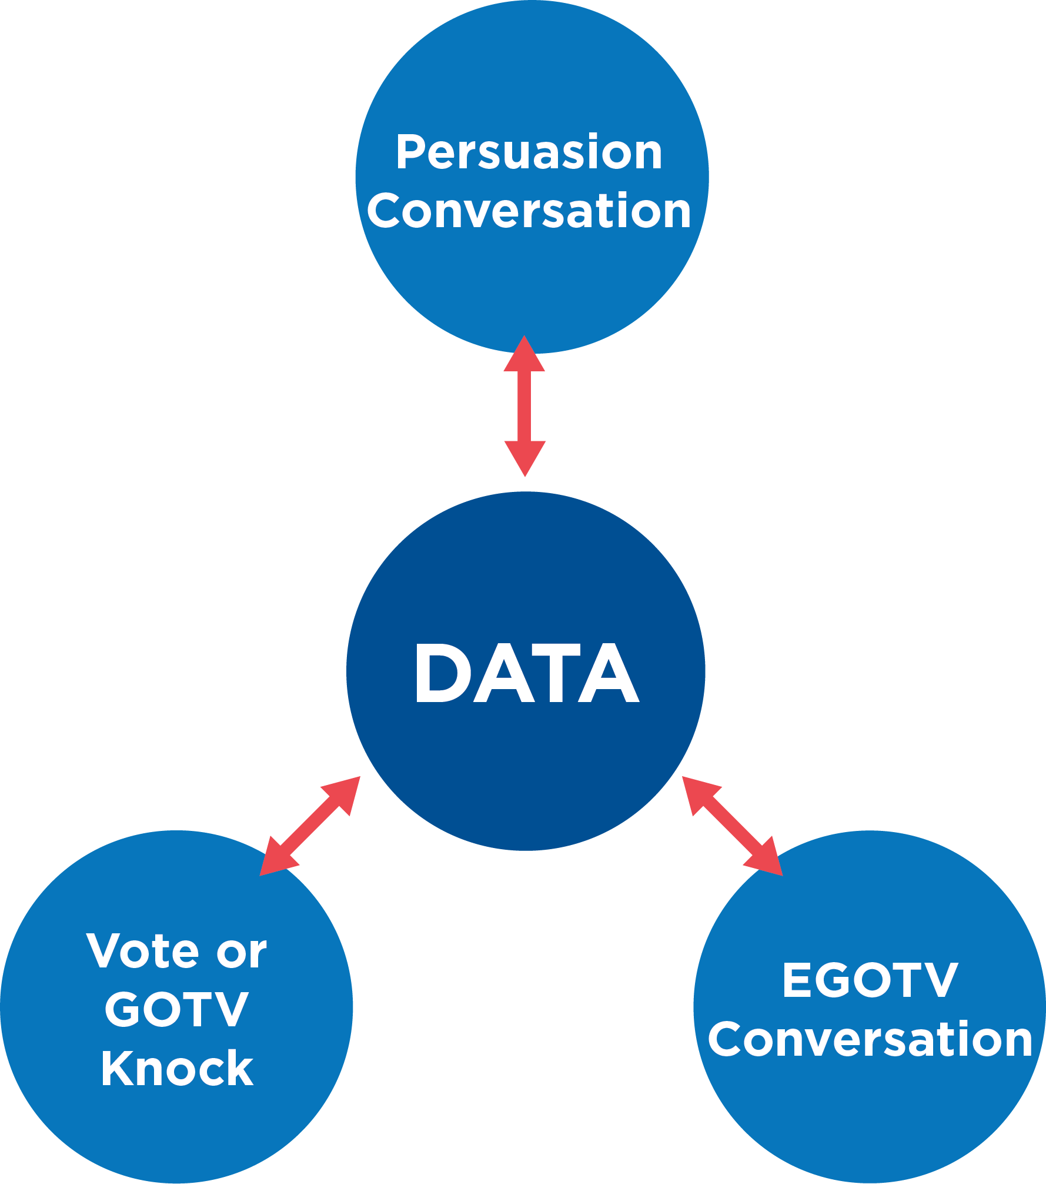
HOW VOTER CONTACT LEADS TO VOTER TURNOUT
Notes:
LANGUAGE: All during elections and past elections, we’ve collected data doing voter contact. For candidates and campaigns, they’ve had persuasion conversations that help inform them have conversations with their supporters. We’ve had conversations to ensure that our Democratic base plans on voting. All of this data on voting plans during EGOTV is entered and informs us whose doors we need to knock on during GOTV!

Slide 33
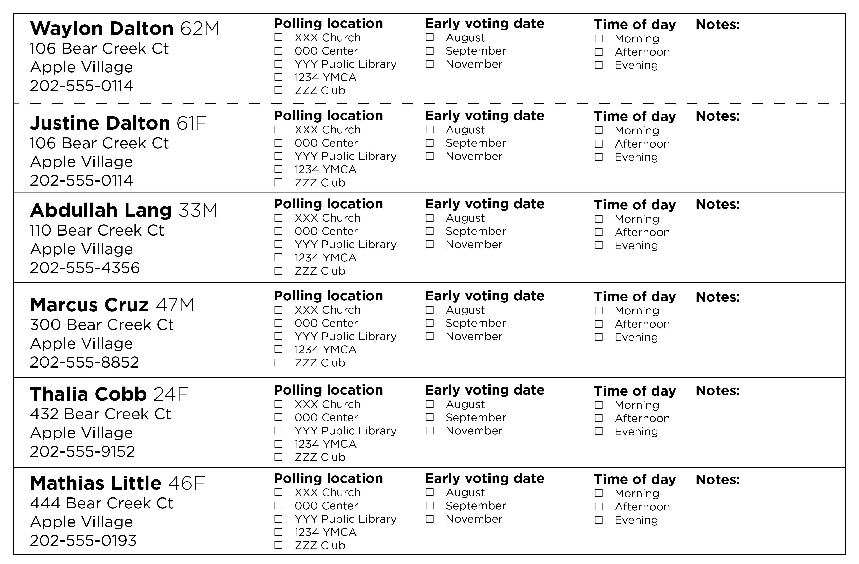
CONTACT LIST ACCURACY
Notes:
LANGUAGE: Because this data is so important and can have an impact on the future, it is important to always identify the voter at the door who you are contacting. You are confirming the information on the contact list and providing any updates so that your GOTV knocks are the accurate people who you need to get out and vote.

Slide 34
DATA
Notes:
LANGUAGE: When canvassing, you have to capture each detail and mark it clearly, too. This will make repeating a vote plan back to a voter easier. It will also help you or other canvassers reference a vote plan on a future GOTV conversation during the election period. In addition to shorter term data information for the election cycle, this data can provide insight for future election cycles with people’s preferences with early voting and if they have a history of voting early.

Slide 35
HOW VOTER CONTACT LEADS TO VOTER TURNOUT
Notes:
LANGUAGE: The more data we write down, the more effective our conversations are!

Slide 36
LET’S PRACTICE!
Notes:
Note: This practice session takes 15-20 minutes. It involves 2 activities.
Language: Now that we’ve connected how essential recording and maintaining data are to voter contact, let’s dig in a little bit deeper with GOTV conversations. In this practice session, you’re going to navigate the script, questions, and data while conversing with a voter who is NOT excited about voting and not interested in voting this year. The script featured the persuasive reasons of why the election is so important will be helpful here. Also, you have such an important role here with having voters understand their impact that they have in their communities (and community decisions) when they vote.
Activity 1: Return to the first practice partner you had who you only asked the questions to. Partner 1 will be the canvasser and have a complete GOTV conversation with Partner 2, a hesitant voter. Partner 1 will manage recording the data accurately during the conversation and repeat the vote plan back to Partner 2 in the end, along with giving them the written details of Partner 2’s vote plan. Partner 2 will then provide 2 minutes of feedback about how Partner 1 convinced Partner 2 to vote and how thorough Partner 1 was with their questions and detail recording. This will take 5-6 minutes total. Then you will switch roles.
Activity 2: Now, we’ve practiced recording GOTV conversation data, and we’ve practiced convincing a voter that they need to vote. I want us to call out a few examples of voter plans and provide some constructive feedback. For example, what is the most vivid part of the vote plan described? is anything missing that should have been discussed? Could a detail have been more specific? (Call on 2-3 participants to share someone’s voting plan that they had written down, and walk through each one as a big group).

Slide 37
TAKEAWAYS
Notes:
Facilitator Language: ”For those of you who have worked on campaigns in the past, how have you seen organizations change in preparation for GOTV? What are the types of shifts that happen? What feels different? [CALL on 2-3 trainees]. Great! Your organization will change because the focus now shifts to actually pushing people to the polls, rather than just persuading people. You will start to feel an exciting sense of urgency.”

Slide 38
AGENDA
1
Welcome, Introductions, and Overview
2
Role in Voter Contact
3
Voter Contact Terminology
4
Talking to Voters
5
Making Vote Plans
6
Connecting Voter Contact and Data
7
Debrief

Slide 39
TAKEAWAYS
Notes:
Language: We’ve learned about your role in voter contact, key terminology, how a GOTV conversations flows, and practice what all is involved with making a vote plan with a voter! We’ve done a lot today and practiced making vote plans in different contexts. We’d love to hear a takeaway about what you’ve learned and how you’re feeling about having GOTV conversations with voters. What felt great? Confusing? Surprising? (Call on 2-3 participants).
If there is extra time, ask for any remaining questions audience members may have.

Slide 40
Notes:
Title Page – Option 1

